Slide 1
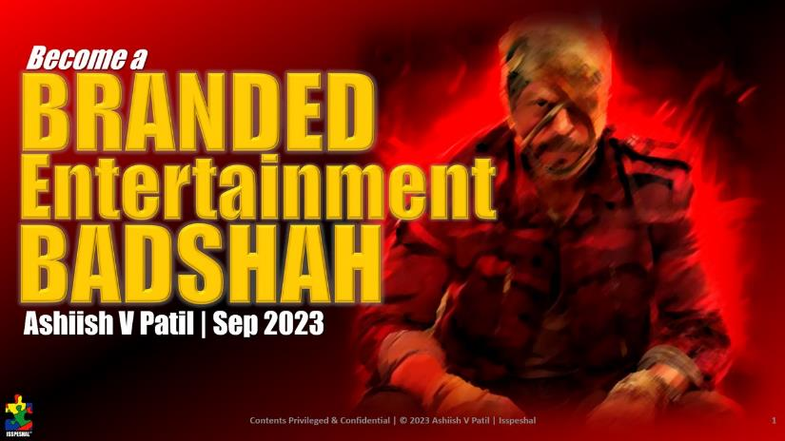
Snapshot from Branded Entertainment workshop | Pilot testing the theme/ some content from the book
Workshop duration: 90 mins | Format: [Virtual] Zoom conference
Platform: LinkedIn | Feedback: Google form [Link]

Slide 2
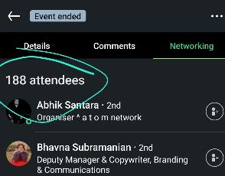
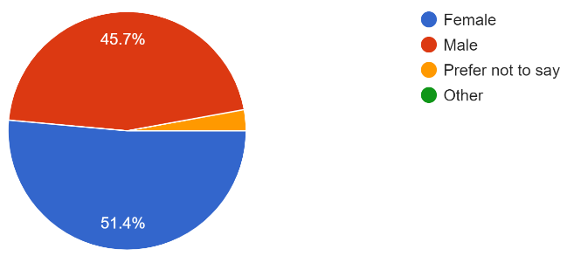
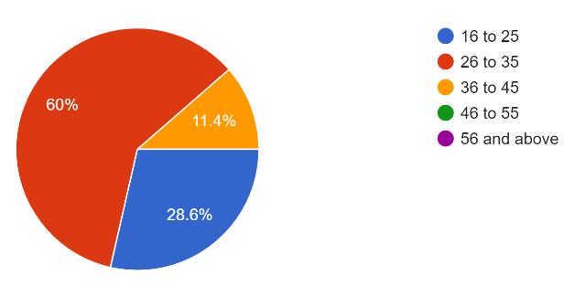
Attendee Profile [Mum-Del-Blr took up almost 65%, but a bunch of smaller cities clocked in]
Delhi-NCR-Gurgaon: 25%
Mumbai: 23%
Bengaluru: 14%
Pune: 9%
Hyderabad: 6%
Others included: Kolkata, Indore, Nagpur, Alwar, Vapi, Ratnagiri, Udaipur, Vadodra

Slide 3
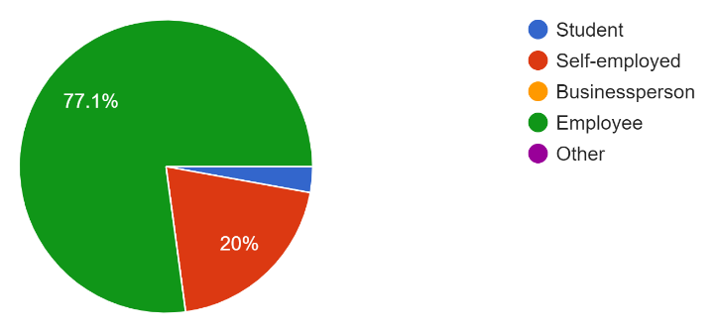
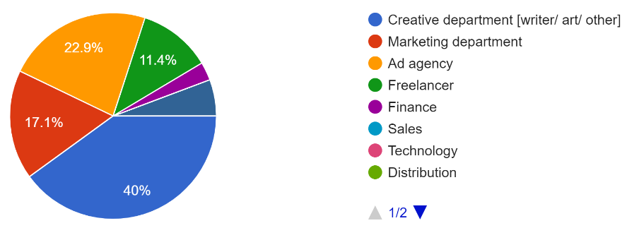
Work Profile [77% included employees and 80 to 90% from Marketing/ Advertising Creative teams]

Slide 4
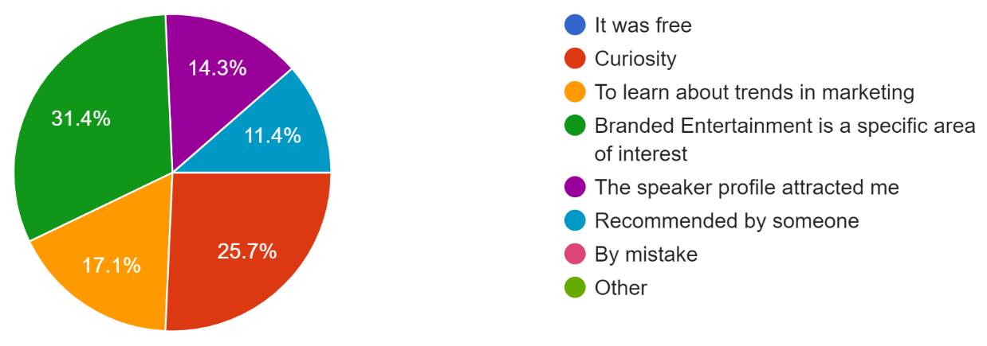
Why they attended the workshop… [75% did because of the content/ speaker profile/ recommendation]

Slide 5
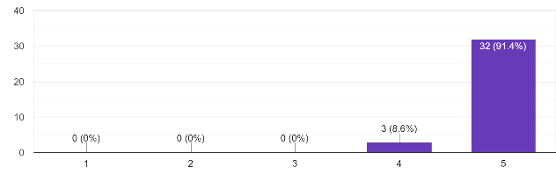
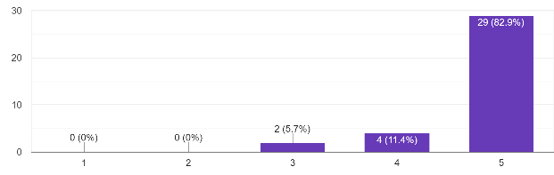
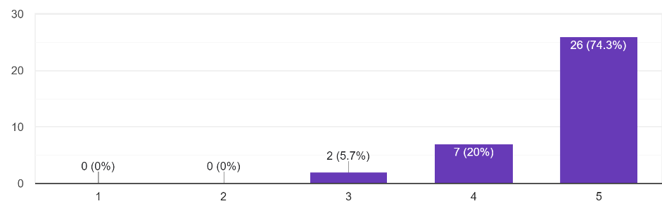
How entertaining, insightful, practically usable was the workshop?
100% found it very entertaining
100% found it very insightful
100% found it practically usable

Slide 6
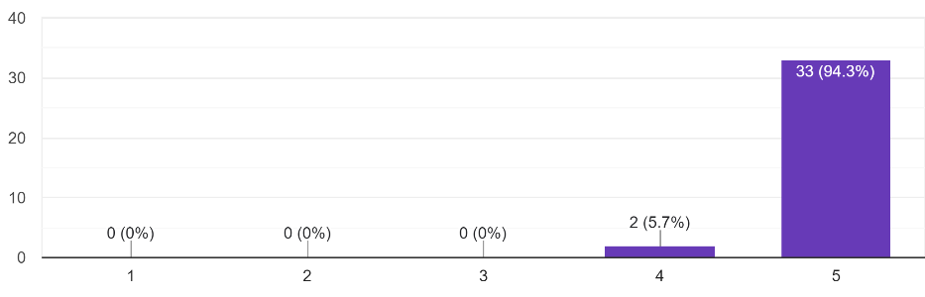
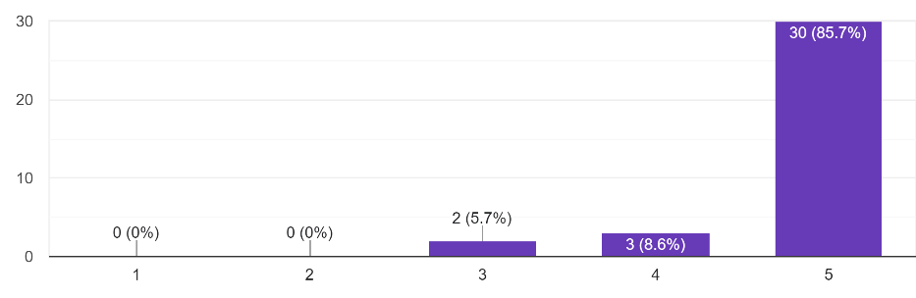
Perception about instructor’s expertise on subject matter & presentation style
94% found instructor’s knowledge of the subject to be at ‘Boss’ level and 6% as very good.
86% found the presentation style great fun and 14% as very good.

Slide 7
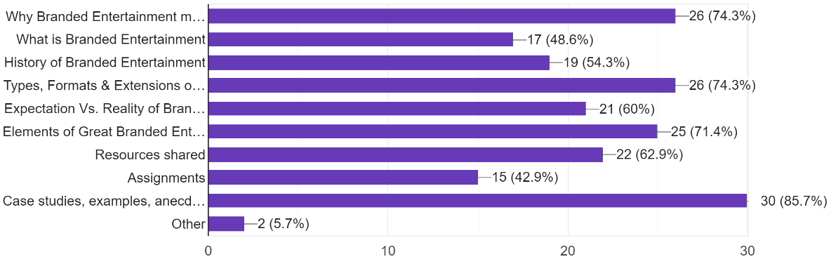
Most Useful Topics [Practically all of them, but specifically, the why/ different formats/ elements of branded entertainment and examples shared were the most handy… Assignments were the least… lazy bunch! ☺]

Slide 8
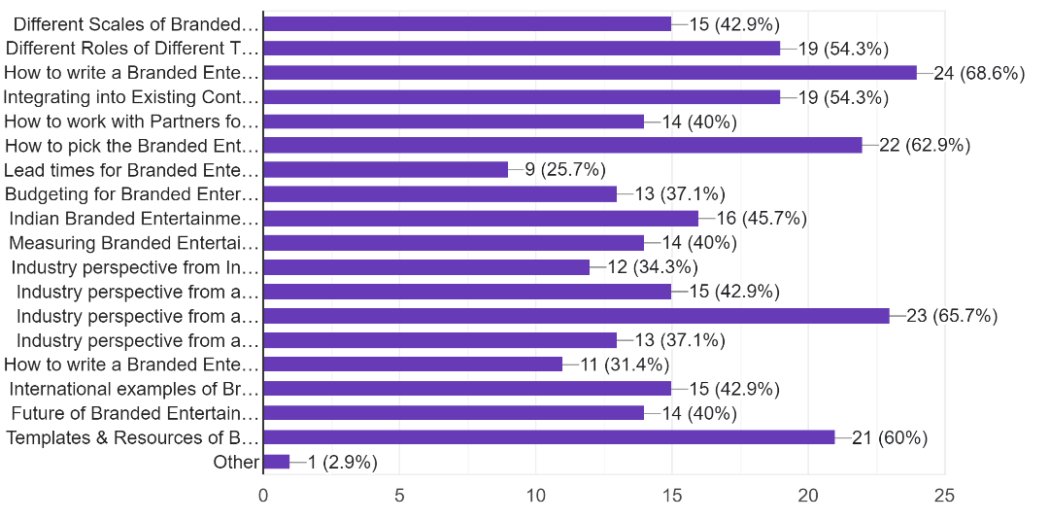
Topics they’d want covered [Practically all the balance lessons from the book, but specifically, writing a brief, picking the right formats, the resources and templates, industry perspectives]

Slide 9
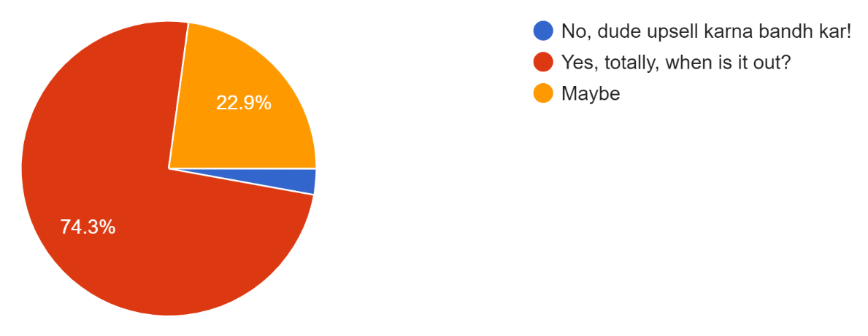
Would they be interested in buying a book on Branded Entertainment by Ashiish? [74% resounding YES and a 23% linked to pricing]

Slide 10
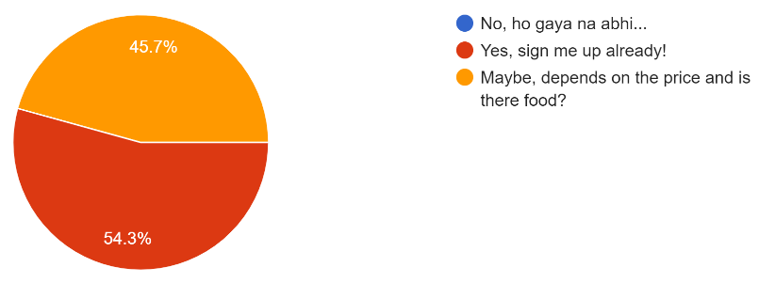
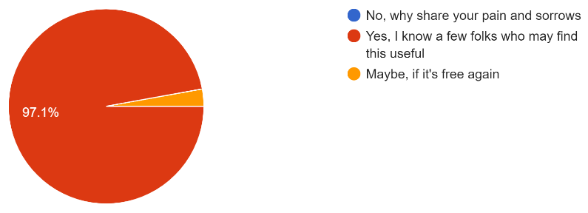
Interest in a longer paid online course…
54% were happy to sign up and 46% subject to price being right.
97% were sure to recommend it to others.

Slide 11
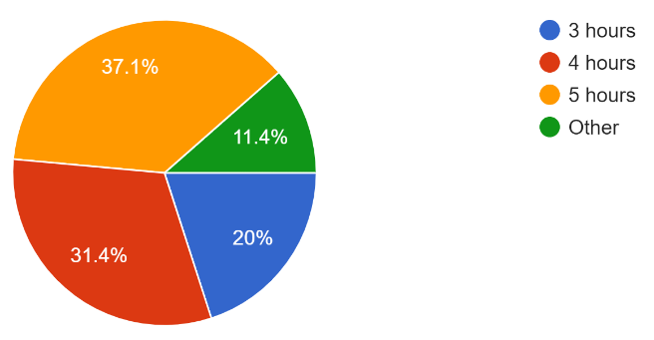
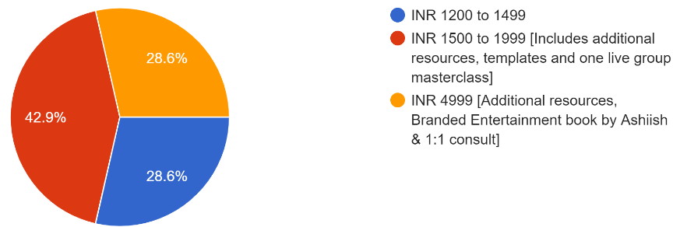
Feedback on duration/ pricing for online course…
For 88% odd, 4 to 5 hours seems like the right duration for an online course with pre-recorded videos of avg. 10-15 mins duration per lesson.
For 43%, INR 1500 to 1999 seems like the sweet spot but... There are 29% willing to pay up to INR 4999 when bundled with the book and a 1:1 interaction.

Slide 12
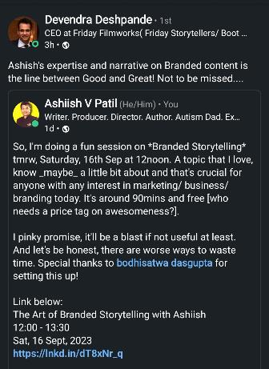
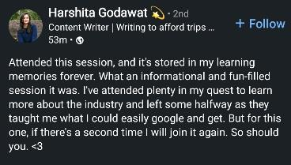
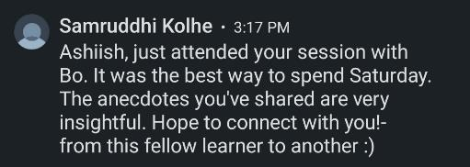
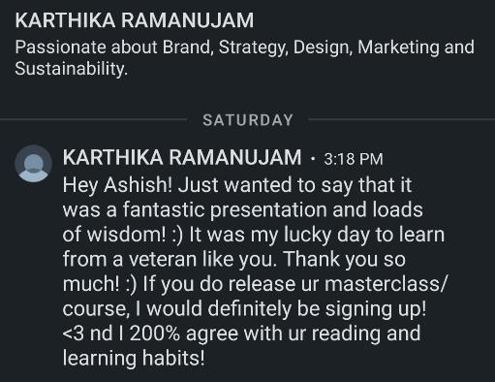
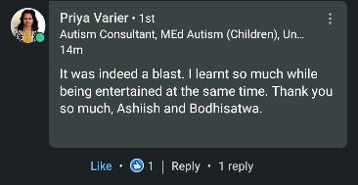
Comments and more…
Bodhisatwa is an ad guru, the workshop was organized by/ for his cohort
CEO, Neeraj Pandey studio

Slide 13
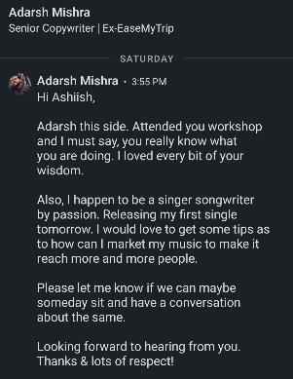
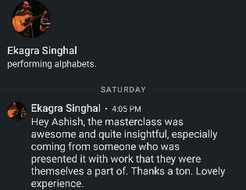
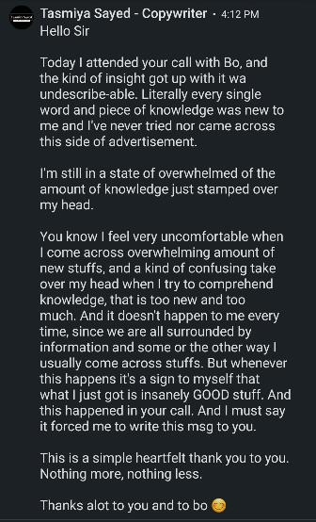
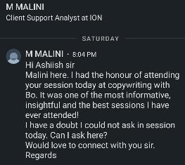
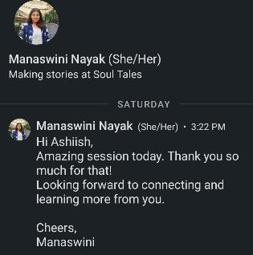
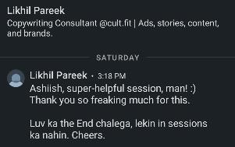
And some more…

Slide 14
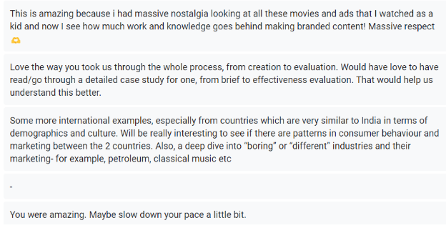
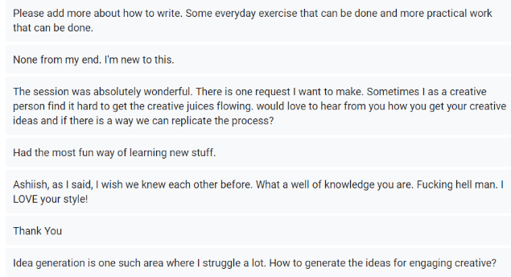
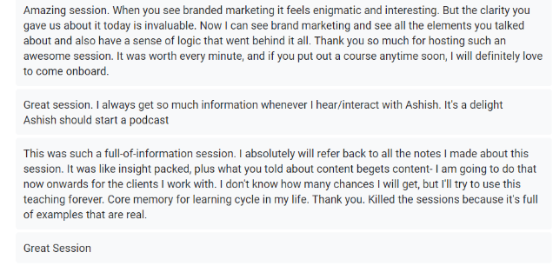
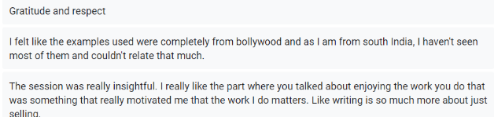
And then some more…

Slide 15
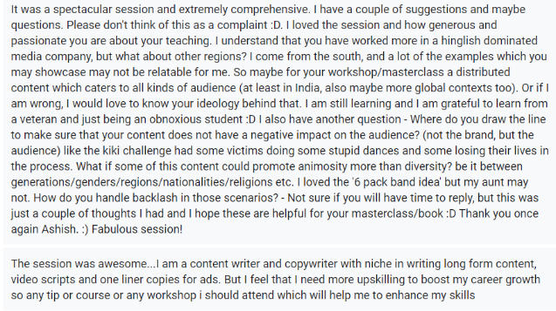
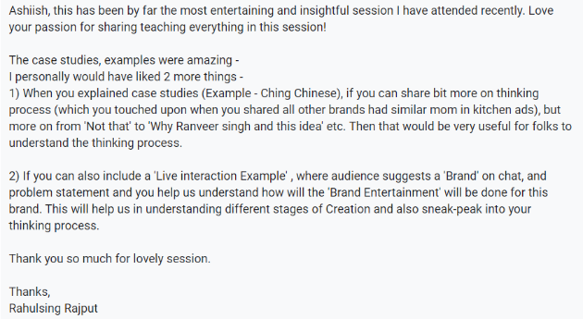
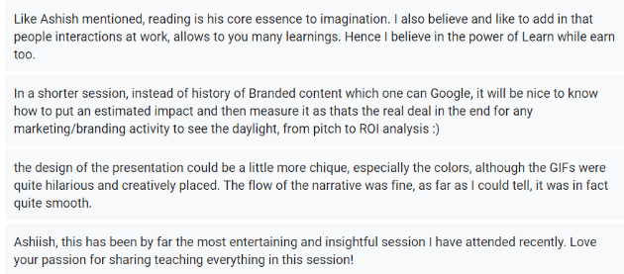
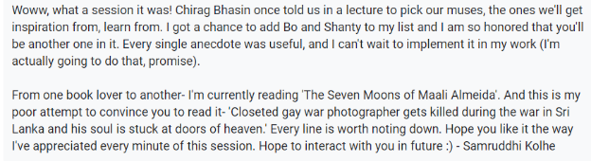
And wait for some more…

Slide 16
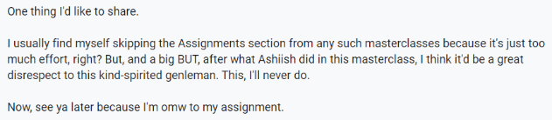
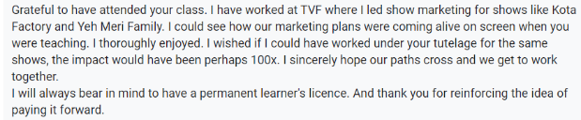
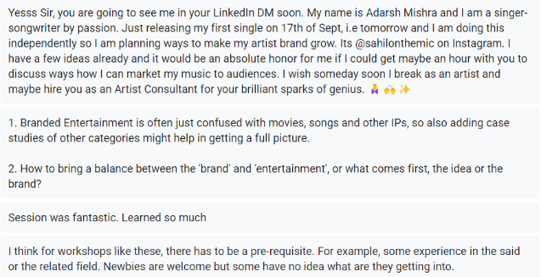
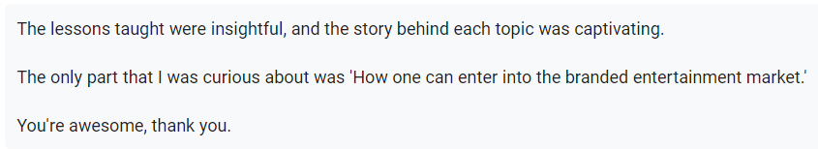
And more…

